Slide 1
Case Study
By Santosh Bisht

Slide 2
Problem statement
Please use the JSON file (140MB, ol_cdump.json) and perform the following:
Load the data and print/make yourself familiar with the schema. Count the rows in the (raw) data set.
Apply some data profiling on the data set and suggest three data quality measures to improve the data set for the purpose of this case study
Make sure your data set is cleaned, so we for example don't include in results with empty/null "titles" and "number of pages" is greater than 20 and "publishing year" is after 1950. If you decided to add additional filters due to the data profiling exercise above, pls. state them as well. Count the rows in the filtered dataset.
Run the following queries on the cleaned dataset:
Get the first book / author which was published - and the last one.
Find the top 5 genres with most published books.
Retrieve the top 5 authors who (co-)authored the most books.
Per publish year, get the number of authors that published at least one book
Find the number of authors and number of books published per month for years between 1950 and 1970!
Let's assume that you want to create a very simple interactive website (pagesbyauthor.com) where a user can provide an author and the website will provide the total number of pages that this author has written across all the books. Please create an architecture to achieve this (no need to do any implementation on this), keeping the following in mind:
How will you handle changing or evolving schema?
How do you want to store/partition the data?
Would you go for on-premise or for a cloud-based solution? Why?
How would you do the reconciliation testing?

Slide 3
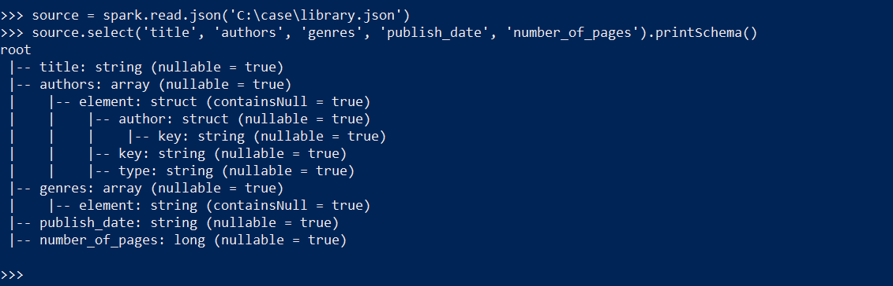
Load the data and print/make yourself familiar with the schema. Count the rows in the (raw) data set.
Total number of records -> 148163
Schema

Slide 4
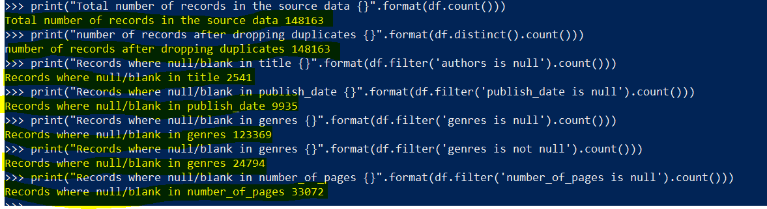
Apply some data profiling on the data set and suggest three
If we don’t consider the publish_date with year value only then records decrease drastically
Number of records after date_reconcile not considering if only year present -> 1815
And when we consider it then the number of records are -> 112989

Slide 5
Steps I followed :
Requirement
Main data points for the analysis.
Data cleansing and reconciliation
Data quality checks.
Storing the data.
Running the queries.
Data Requirement:
Raw data source: Json dump file.

Slide 6
Requirements:
Data should be cleaned and transformed before doing analysis.
Analysis required for the below columns in the data.
Book title
Published year, month
genres
Author’s Information
Published month
Number of pages
Anomalies I found regarding these columns:
Book Title:
Number of records check.
Title is must for all the analysis, and it should not be null or blank.
We can check for duplicate entries for this column, and this can be possible, as with same name we can have multiple books.
To check the duplicate entries, we can consider other attributes like author, publish year, genre

Slide 7
Authors:
Author’s information is not in a human readable format in the given raw data, end_part of URL is present as value.
There is a question regarding parsing the author’s information. Authors field contains the data in a list of list elements.
What element should be considered as main author and co-author?
If we consider first element as main author, then what should we do if the first element is blank and second is main author?
If we pick the first element as main author, then should we consider the records where first element is absent?
When I hit the URLs then found that the both records referring to the two editions of it.
Publish year:
We need to extract it from publish date, as this is mandatory column for some analysis hence, we can not expect null or blank.
Publish date must have the data with date format, we can’t expect incomplete date information in this field.
Genres:
Data needs to be cleaned.
Remove those Genres which does not make sense, like etc, . 11

Slide 8
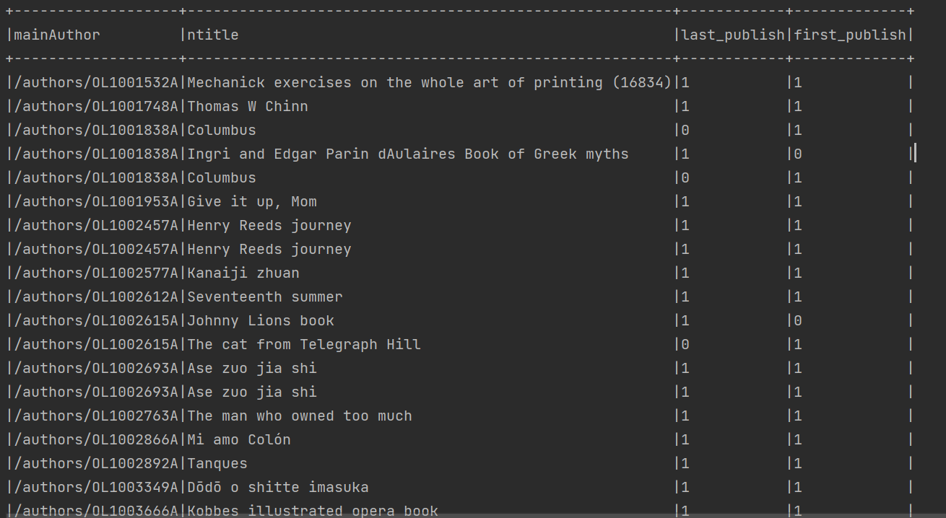
Get the first book / author which was published - and the last one. Code is attached separately.

Slide 9
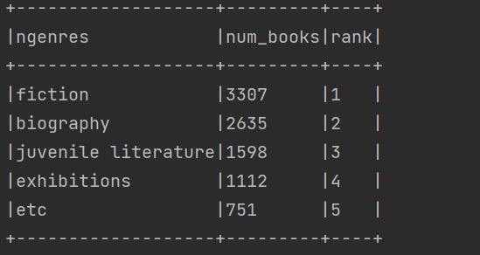
Find the top 5 genres with most published books.

Slide 10
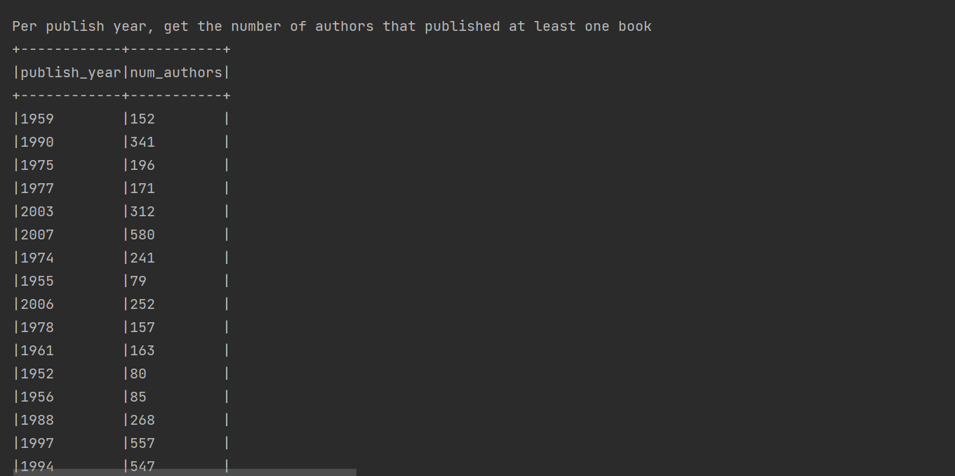

Slide 11
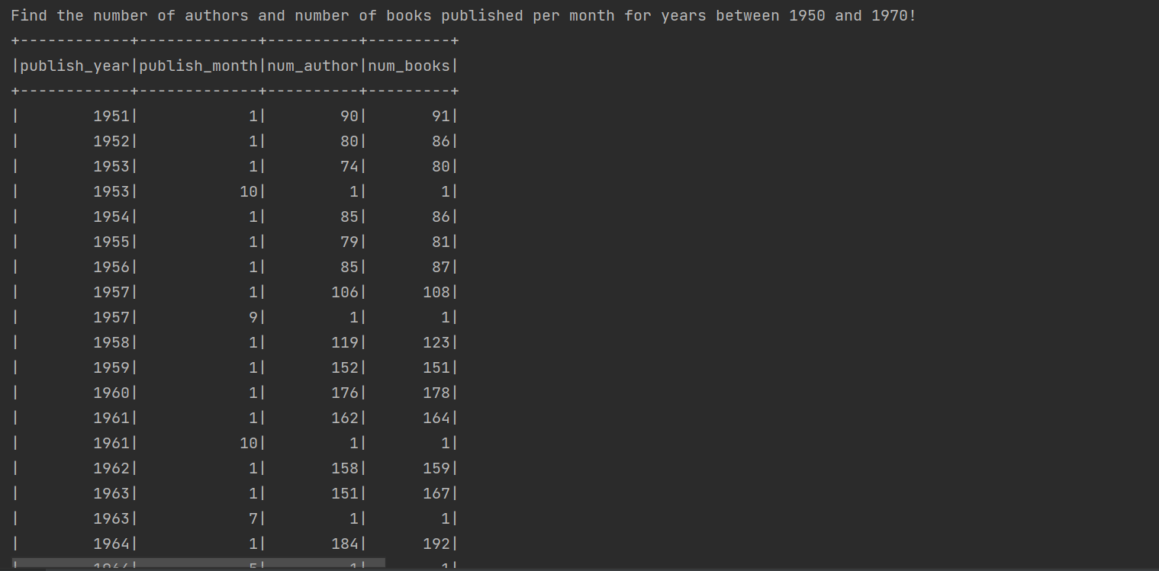

Slide 12
Processing Engine
UI
DATA SOURCE
Pre-processing
comparison
postprocess
Data storage
Config files
Schema files

Slide 13
How will you handle changing or evolving schema?
I will use Avro for this purpose, where I can do the versioning of schema and handle such situation easily.
How do you want to store/partition the data?
It totally based on what query we want to run, if we want aggregated results only based on author then it would be netter to have the data partitioned by author key to leverage partition pruning and predicate push down filters.
Would you go for on-premise or for a cloud-based solution? Why?
Definitely go for cloud-based.
Low maintenance cost.
Pay according to your usage.
Scaling up and down facilities.
Very rare down time.
Better backup plans.

Slide 14
How would you do the reconciliation testing?
This we can achieve in three categorization.
Mater data reconciliation, here we can test below thing
Total number of rows
Total Customer in source and target
Total number of Items in source and target
Total count of rows based on given condition
Number of active users
Number of inactive users
Transactional Data reconciliation to test.
Sum of total income calculated from source and target
Sum of the entire item sold, calculated from source and target, etc.
Automated Data Reconciliation:
In large Data warehouse management system, it is convenient to automate the data reconciliation process by making this as an integral part of data loading. It allows you to maintain separate loading metadata tables. Moreover, automated reconciliation will keep all the stakeholders informed about the validity of the reports. Tool are like google refine.

Slide 15
How would your plan for the first 90days in this role look like?
I think the first quarter in any organization is very important and it decides that how I will succeed in my role. The basic principle to work in first 90 days is like break it small chunks, 30-60-90 and start with learning, planning and execution.
Learning (First 30 days): New organization, new role, and new relationships, its all about learning and noting it down. So, I will try to get all the knowledge about projects, Org-structure, contact persons for different tasks, and will create strong relationship with team members and other key people because they will help me in next coming months or year.
Plan and execution (next 30-60days): In this stage, I would be having some good contact and understanding of organization and process hence I can build a plan using fundamental building blocks that these can be used in execution stage. I will ensure that I have talked to key people who can help me to execute my plan. Check all the angles of your plan and prepare some backup of it too.
Once plan is ready, I can work on executing it. It is like running my new car which I just bought. This will tell me how the things I had planned, area of improvement, people who helped me, the things which didn’t go as per plan.
So based on these 90 days, I can plan coming days in this role.
How would success after 2-3 years for you look like and how would you measure it?
I will setup some professional and personal goal for me and accordingly will decide that if I have succeeded or not.
Professional goal would be to contribute actively to reshaping architecture. So that If I do assess my self again after 2-3 years then I can say that I’ve contributed to this component, and it is running without any issues.

Slide 16
In personal level, I will compare my current situation with the situation after 2-3 years, like what all the new things I have learned on my new role in the Adidas?
How comfortable I am, with my collogues and neighbors and vice-versa as this would be a totally new experience for me to work in another country and different work culture?
3. What are the things you might struggle with and how would you overcome it?
I will handle any struggle if I face, with my older experiences and with the help of appropriate person who can help me on that situation.
4. How would you personally approach the challenges, we are facing as a team (see p.3)?
So, If I talk about technologies silos then it can be due to different reasons, like the tech we are using not talking to each other, there is no healthy competition across the teams, so they are holding some data due to that some information is in hold. So, I would work on below points to short-out these challenges.
First collect all the data points that what is causing the Technology Silos.
Then talk to stockholders who are using our generated output and discuss with other teams too who were facing similar kind of problems and they have progressed well in the resolution.
List down all the tech stack that is not fitting with most of the components which we use in our pipeline. Search for there alternative and then do the POC, share key results and plan a migration based on key results.
Acquire tech, tools resources for this migration.
Architect, develop, test and deploy.
Educate support team for this migration activity and give them a handy documentation for any production related issues.

Slide 17
5. Can you share some examples, where you were mentoring some more junior team members and what you learned from it?
Yes, I have mentored many of them in the current organization, I work according below steps to mentor a junior
First listen them and make them comfortable when they are taking to you.
Once they are comfortable with you, then they can expose their strength and weakness.
Assign some work to them according to their strength. Praise them in front of other team members for the completion of the task, this will build their confidence and help them to take the challenges.
Assign some small problem from their weaker area, and time to time take an update on that. If they are facing issues, then ask them what all the solutions they have tried. And explain them why those not worked, that will help them to find the solution by themself.
If there is some issues or delay on their tasks, then try to safeguard them and have a separate meeting with them to explain them that what impact this issue has caused, and next time how he can avoid such situations.
Have a time-to-time session with them and discuss what they have learnt, what their expectations, tell them what are the company goals and how they are contributing to them. This will make them feel that they are adding a great value to the company.

